Slide 1

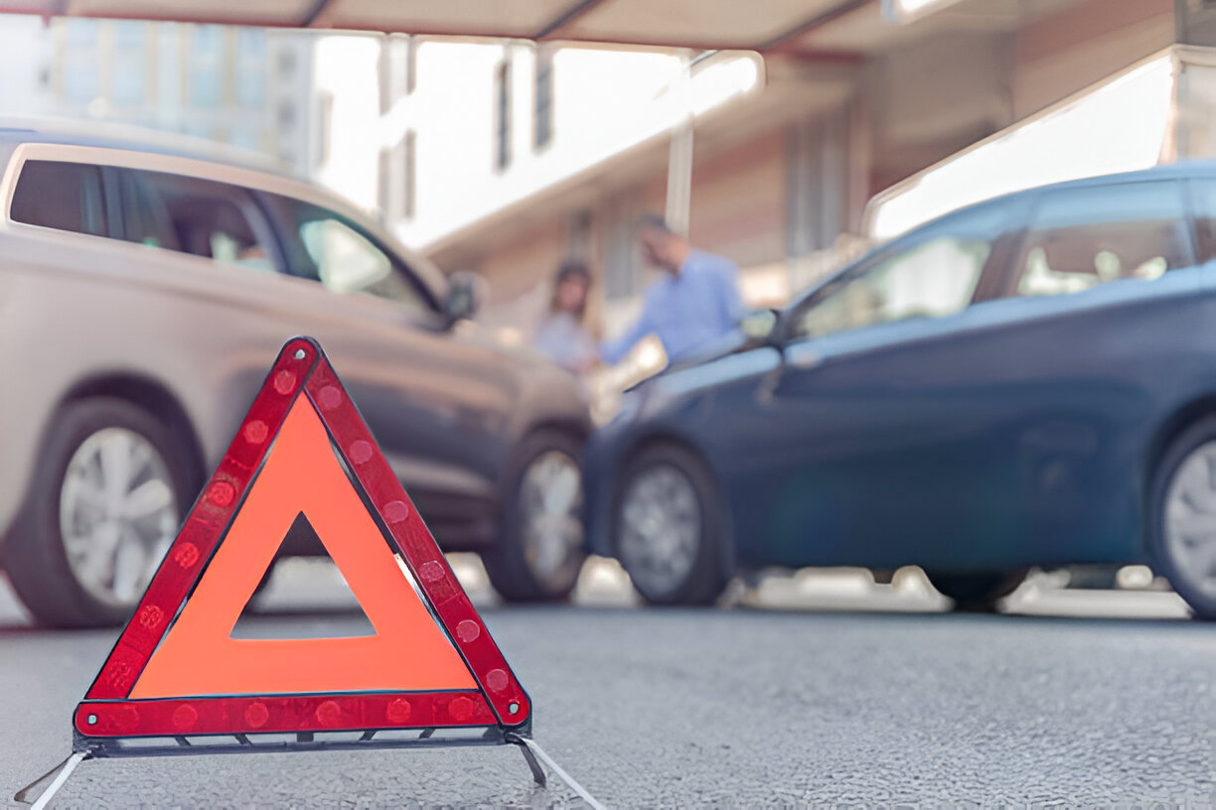
TRANSPORTATION SAFETY ANALYSIS IN THAILAND
Investigating Patterns and Risk Factors in Road Accidents
Presented by: Group 15 (Transportation) TDI
December, 2024.

Slide 2

Overview
01
05
Findings and Insights
Introduction
02
Problem Statement
06
Recommendations
03
07
Conclusion
Project Objectives
04
Data Overview

Slide 3
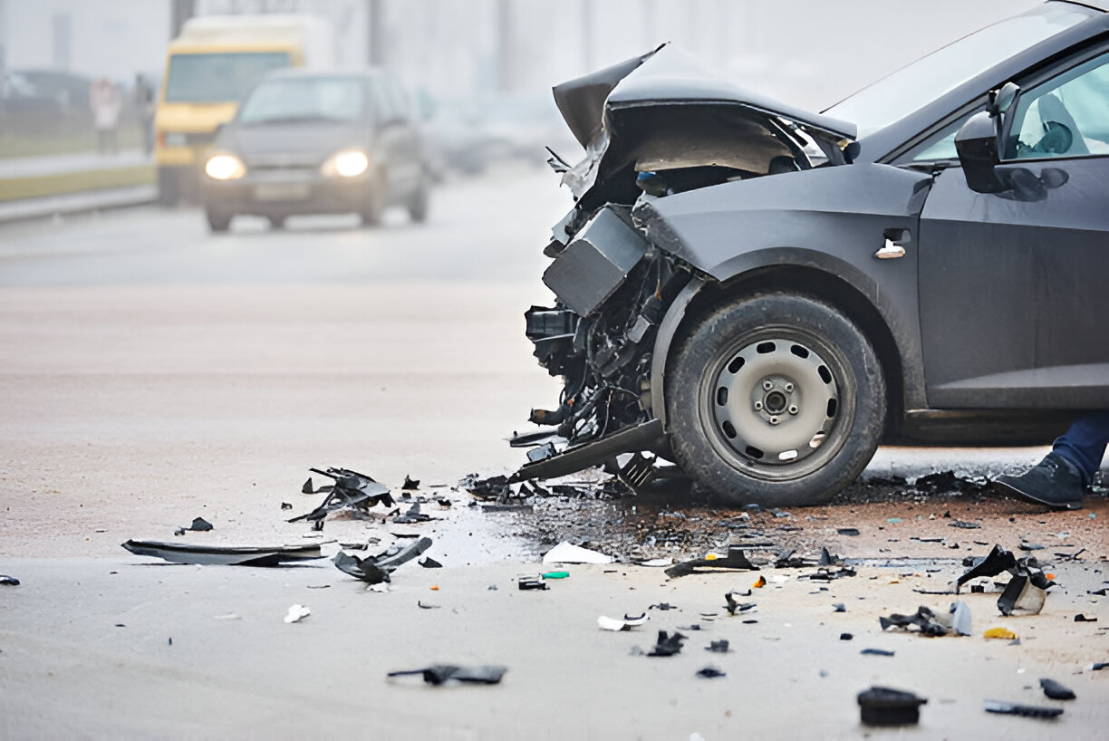
Introduction
As part of a high-priority project within our data analytics team, this report investigates patterns and risk factors in road accidents across Thailand. Understanding these factors is crucial for developing strategies that reduce accident rates and enhance public safety. This dataset integrates multiple sources to capture essential accident-related details.

Slide 4
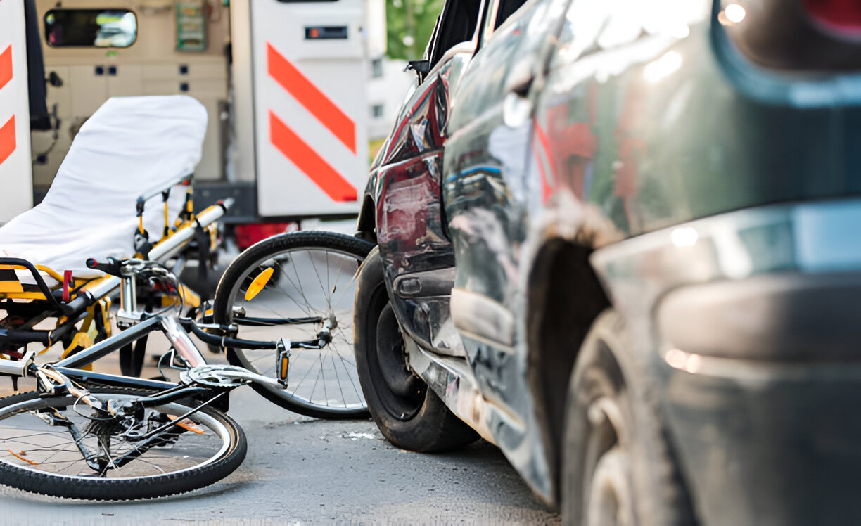
Problem Statement:
Roadway accidents present serious safety challenges with both human and economic costs. This project aims to identify key factors influencing accidents—such as environmental conditions, geographic specifics, and incident characteristics—and leverage these findings to guide targeted safety interventions, reduce collisions, and improve traffic safety.

Slide 5

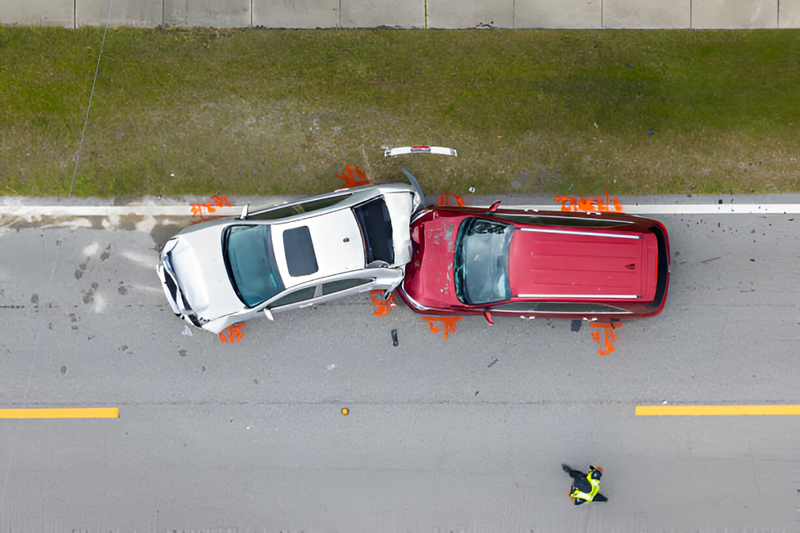
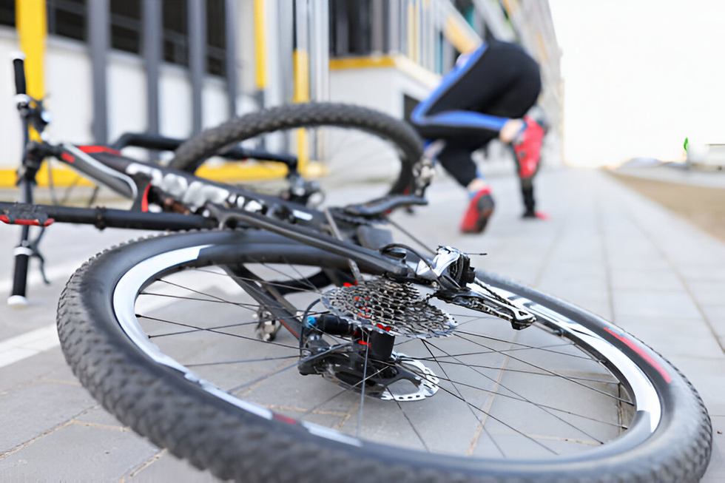
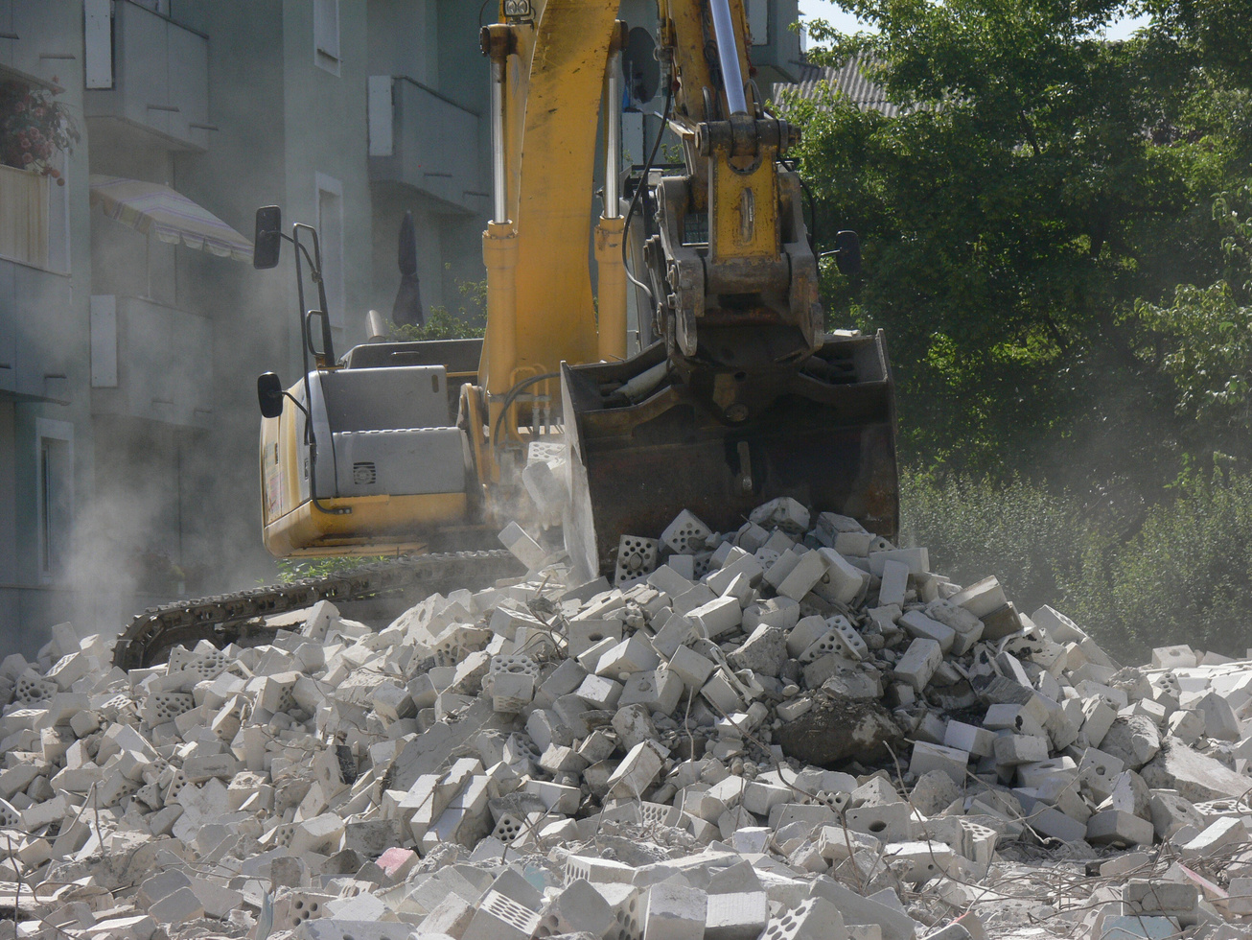
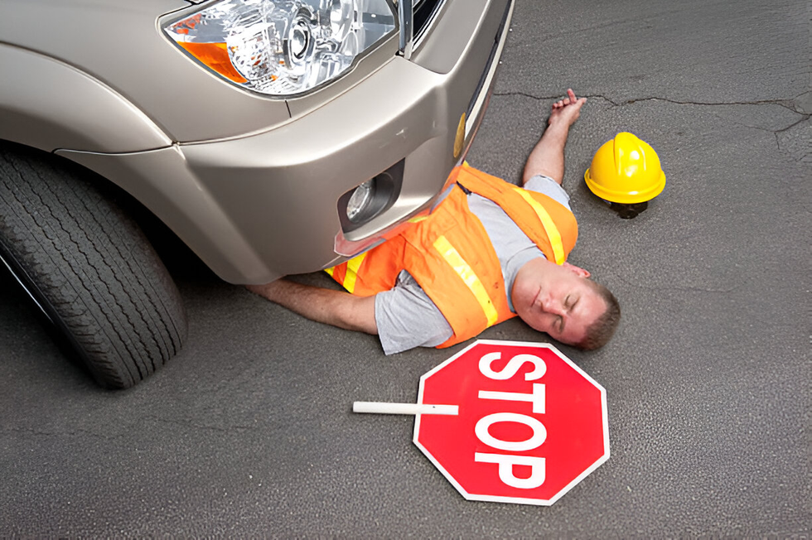

Project Objectives
1. Determine the Frequency and Distribution of Accidents:
Evaluate Vehicle Involvement and Accident Types:
Develop Safety Recommendations:
·Analyze accident data across different provinces to identify high-risk areas.
·Assess trends over the years to understand if accident rates are increasing or decreasing.
Categorize accidents based on vehicle types to understand which vehicles are most commonly involved.
·Analyze different types of accidents (e.g., rollovers, collisions) to assess their severity levels.
·Use findings to suggest safety improvements for specific provinces or conditions (e.g., better road maintenance, signage improvements).
·Recommend targeted interventions for accident prevention based on common causes.

Slide 6

Data Overview
Accident Road Condition: Contains information on road and weather conditions, including weather type, road and slope descriptions.
Accident Report Details: Provides details on when accidents were reported, including date, time, and year of reporting.
Accident Incident Details: Focuses on the specifics of accidents, such as the date, time, and year of occurrence.
Accident Information: Offers foundational accident data, including vehicle types, presumed causes, accident types, and counts of injuries or fatalities.
Accident Location: Contains geographic and agency-related details, including province, reporting agency, and latitude/longitude coordinates.
Data Source; The dataset was compiled from Thailand Road Accident [2019-2022]

Slide 7
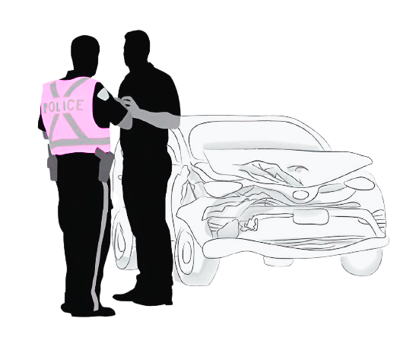
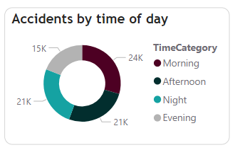
Data Analysis:
1. Accident by time of day:
This chart shows that most accidents occur in the morning, likely due to rush hour traffic congestion from people commuting to work or school.

Slide 8
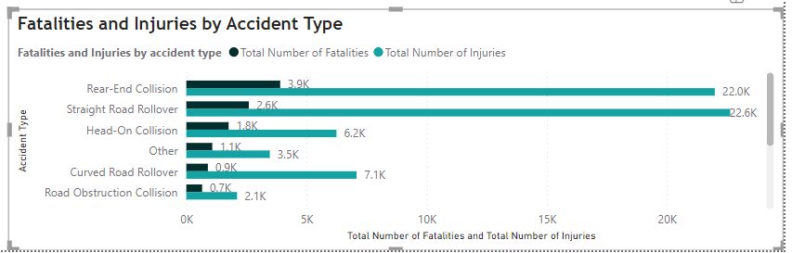

Fatalities and Injuries by accident type:
The chart shows that straight road rollovers result in the highest number of injuries, with 22.6k recorded, highlighting their significant danger in causing injuries.
Rear-end collisions have the highest fatality count, with 3.9k deaths, indicating they are more deadly despite potentially causing fewer injuries overall.

Slide 9
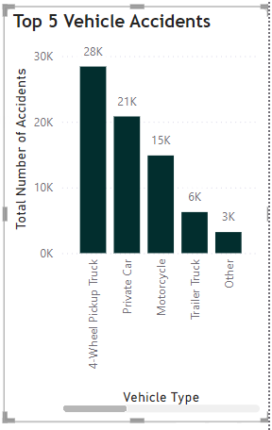


Top 5 vehicle accidents:
The chart shows that 4-wheel trucks (28.4k incidents) are the most frequently involved vehicles in accidents, followed by private cars (20.8k) and motorcycles (14.9k).

Slide 10
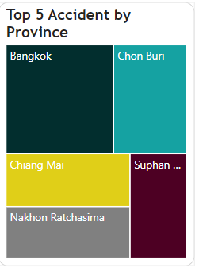
Top 5 Accident by Province:
This tree map is interpreted from the size and placement of province. It reveals that Bangkok has the highest number of accidents, this could be as a result of high population density being the most populous city in Thailand with millions of residents and a constant influx of commuters and tourists.

Slide 11
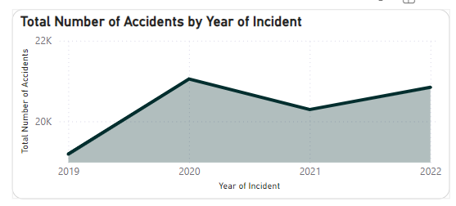
Total number of accidents by a year of incident:
This area chart reveals that year 2020 experienced an usual peak of accidents, this could be as a result of the impact of the covid-19 pandemic.

Slide 12
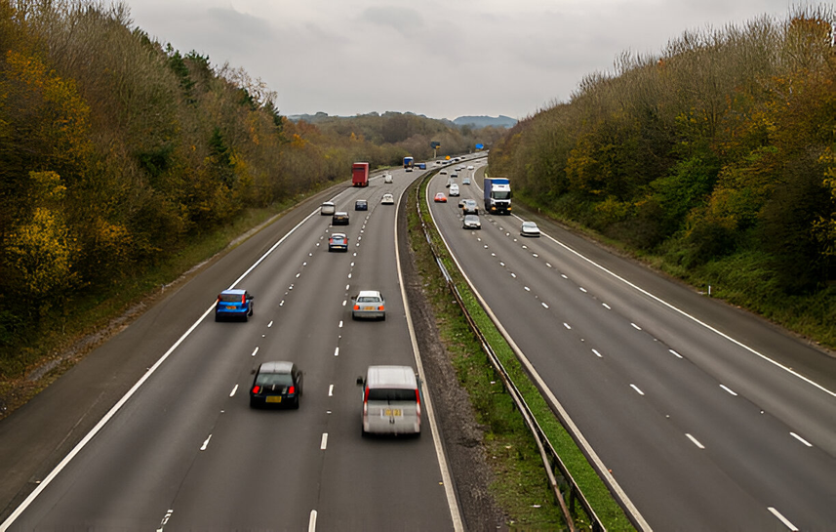

Insight summary:
Morning rush hours cause the highest number of accidents due to traffic congestion.
Rollovers on straight roads lead to the most injuries while rear-end collisions result in the highest fatalities.
Four- wheel trucks are involving in the most accidents, followed by private cars and motorcycles.
Bangkok city experiences the highest accident rate, due to its population density.

Slide 13

Recommendations:
Improve Traffic Management:
Synchronizing traffic lights and introducing bus and carpool lanes can help reduce morning congestion and the high number of accidents.
Improve Road Infrastructure:
To improve safety in high-accident areas like Bangkok, it is recommended to enhance the visibility and clarity of road signs and install adequate lighting to address challenges from fog or sun glare.
Vehicle Measures:
Based on our findings that 4-wheeled trucks contribute significantly to accidents, we recommend loading limits and driving hours to prevent mechanical failures and designs dedicated to trucks on highway to separate them from smaller vehicles and reduce collisions.
Safety Measures:
There should be an enforcement of traffic laws, driver’s education programs and an improvement of emergency medical services to reduce fatal accident and improve survival rates.

Slide 14
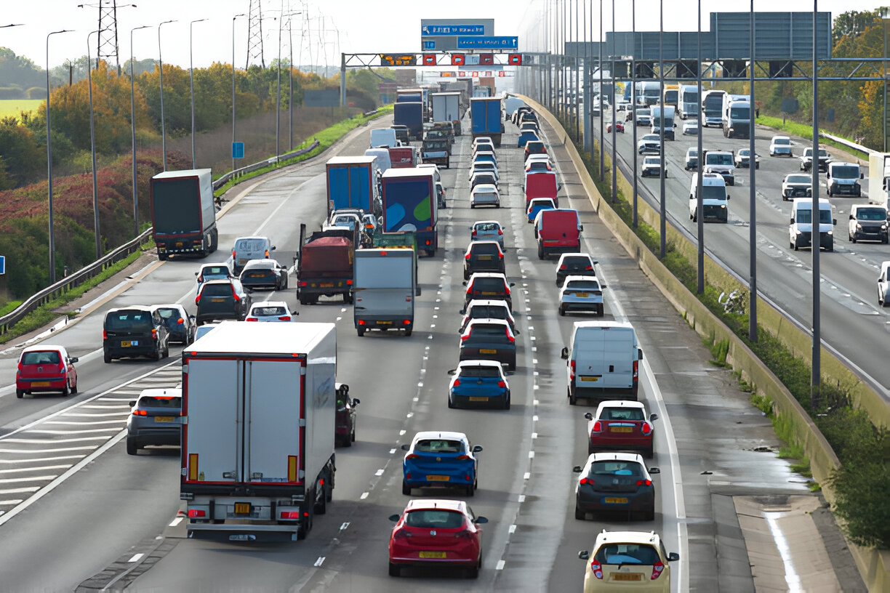
CONCLUSION:
By implementing the above recommendations, the combined efforts will significantly reduce road accidents, enhancing overall transportation safety.

Slide 15
Thank You

